Slide 1
Implementing Jumps
Jump
2
address
31:26
25:0
Jump uses word address
Update PC with concatenation of
Top 4 bits of old PC
26-bit jump address
00
Need an extra control signal decoded from opcode

Slide 2
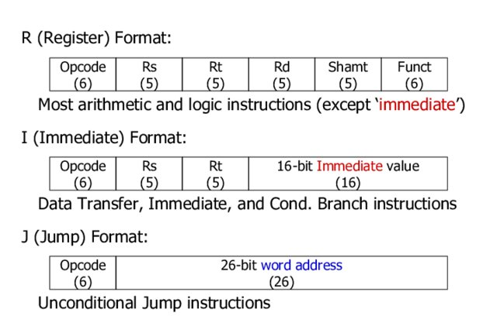

Slide 3
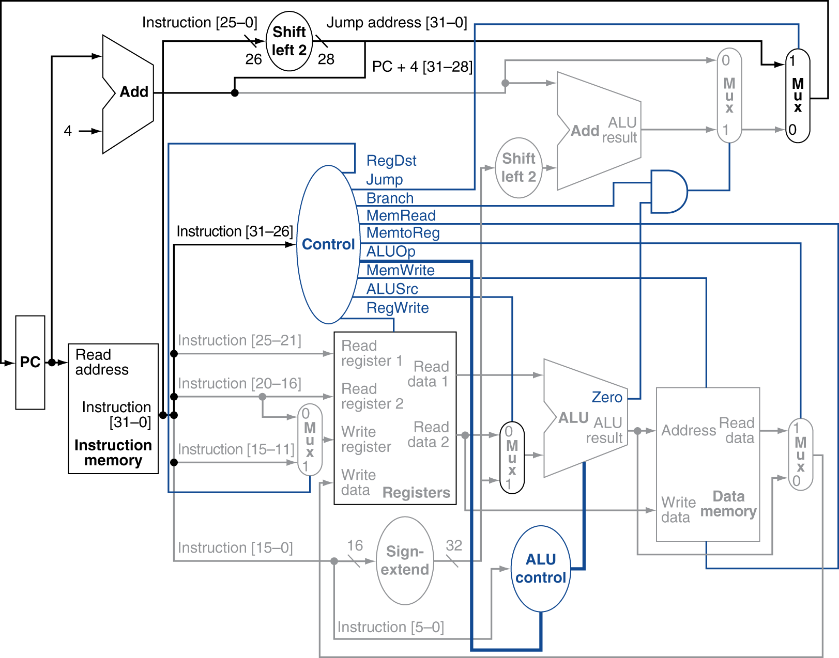
Datapath With Jumps Added

Slide 4
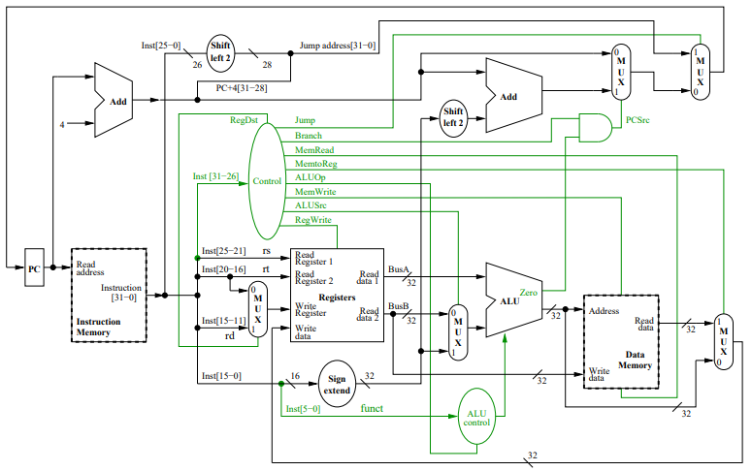
MIPS Data path and control

Slide 5
Single cycle implementation
Also called single clock cycle implementation
An implementation in which an instruction is executed in one clock cycle
Advantage
Easy to understand
Disadvantage
it is too slow to be practical
Why?

Slide 6
Single cycle implementation
the clock cycle must have the same length for every instruction
the longest possible path in the processor determines the clock cycle
a load instruction, which uses five functional units in series: the instruction memory, the register file, the ALU, the data memory, and the register file
Although the CPI is 1; the overall performance of a single-cycle implementation is likely to be poor, since the clock cycle is too long
Solution:
improve performance by pipelining
Similar datapath and higher throughput
Pipelining improves efficiency by executing multiple instructions simultaneously

Slide 7
Pipeline Performance
Assume time for stages is
100ps for register read or write
200ps for other stages
Compare pipelined datapath with single-cycle datapath

Slide 8
